Slide 1

GTZAN - Music Genre Classification
By: Stephanie Benavidez

Slide 2
Introduction
Project is on a classification model on music genres.
According to an article by Ashley King, “the top streaming genres of 2023 so far are as follows: R&B/Hip-Hop, Rock, Pop, Latin, Country, Dance/Electronic, World Music, Christian/Gospel, Classical, and Jazz” (King, 2023).

Slide 3
Data Source
In the,(GTZAN Dataset - Music Genre Classification, n.d.), it has 10 genres of music, with 100 audio files per genre. The 10 genres are :
Blues
Classical
Country
Disco
Hip Hop
Jazz
Metal
Pop
Reggae
Rock

Slide 4
For the research and ethical questions asked throughout this project, they are as follows:

Slide 5

1. Will the model be able to understand the quality of the audio to choose the correct genre?
If the quality of the audio file is good, then yes it will be able to choose the correct genre.

Slide 6
2. Are there enough good-quality audio files to predict the genre?
Yes, there are over 1,000 audio files from 10 different genres.

Slide 7
3. Will the model allow you to know if one of the audio files is not of excellent quality, or is it giving an error that something is wrong?
Yes, I have written an error reading exception in the coding that bypasses the bad file.

Slide 8
4. Can I get at least an 80% accuracy level within the KNN classification model used?
Since the KNN model is set on choosing random audio files, the accuracy level changes with those random files.

Slide 9
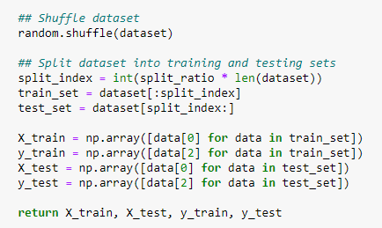
5. Will the KNN Model choose random files?
Yes, the KNN Model is coded to do a random shuffle

Slide 10
6. If the KNN model is choosing random audio files, does that change the accuracy level too?
Yes, each time the model is ran the accuracy level changes.

Slide 11
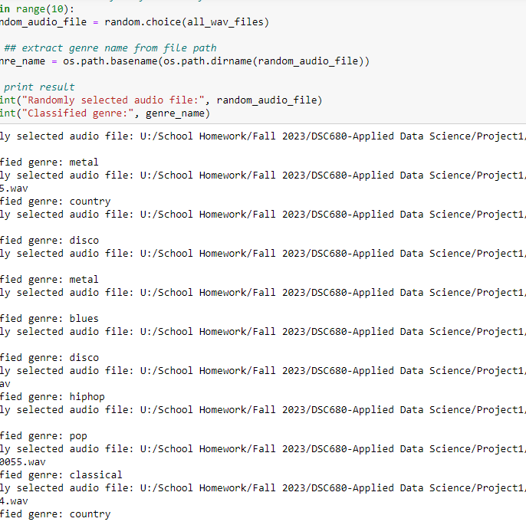
7. If the KNN model chooses random audio files, what is the range that it is set to predict?
Currently, the range is set to 10.

Slide 12
8. Is there anything wrong with any of the audio files?
From the error reading exception, each time I ran the model, the only file that seemed to be corrupt was a jazz audio file.

Slide 13
9. If so, does the coding allow you to see what is wrong with the file?
Yes, the screenshot below shows what is wrong with that audio file.

Slide 14
10. Is there anything else that was trying to be accomplished but couldn’t?
Yes, after the model randomly chose the audio files, I wanted to get the PNG file to pull in together. Unfortunately, I was not able to.

Slide 15
In Conclusion
KNN Classification Model was able to successfully look at 10 different audio files and predict the genres.
The accuracy scores were random, and never saw them over 68%.
KNN Model was also able to do a KNN Clustering Plot based on random files chosen.

Slide 16
References
GTZAN Dataset - Music Genre Classification. (n.d.). Retrieved from https://www.kaggle.com: https://www.kaggle.com/datasets/andradaolteanu/gtzan-dataset-music-genre-classification
King, A. (2023, July 22). Top Streaming Genres of 2023 So Far & Consumption Habits. Retrieved from https://www.digitalmusicnews.com: https://www.digitalmusicnews.com/2023/07/22/top-streaming-genres-of-2023-so-far-and-consumption-habits/
Music Classification: Beyond Supervised Learning, Towards Real-world Applications. (2023). Retrieved from https://music-classification.github.io: https://music-classification.github.io/tutorial/part1_intro/what-is-music-classification.html

